Slide 1
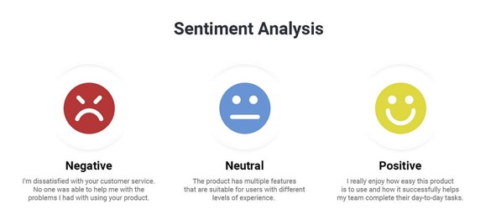
Course-End Project [Capstone Project 2]
Submitted by- Arjun Singh Solanki
Mail-id: arjunsingh.eee11@gmail.com
Submitted on: 31/07/2024

Slide 2
Introduction
The course-end project analyses sentiments expressed in over 34,000 reviews for Amazon brand products within the e-commerce domain. The dataset contains attributes such as brand, categories, review titles, review text, and sentiment levels categorized into "Positive," "Negative," and "Neutral." The project aims to predict sentiment or satisfaction levels based on various features and review text.

Slide 3
Objectives of the Project
Understand the sentiment expressed in consumer reviews.
Address class imbalance in sentiment categories.
Implement classifiers and advanced techniques for sentiment analysis.
Evaluate model performance using appropriate metrics.
Compare traditional machine learning algorithms with neural network approaches.
Explore topic modeling techniques for clustering similar reviews.

Slide 4
Exploratory Data Analysis (EDA):
Exploratory Data Analysis (EDA) techniques will be employed to visualize the distribution of sentiment categories and identify any patterns or trends. Additionally, the class imbalance issue will be addressed by examining the class counts to understand the distribution of sentiments and to determine the extent of class imbalance present in the dataset.

Slide 5
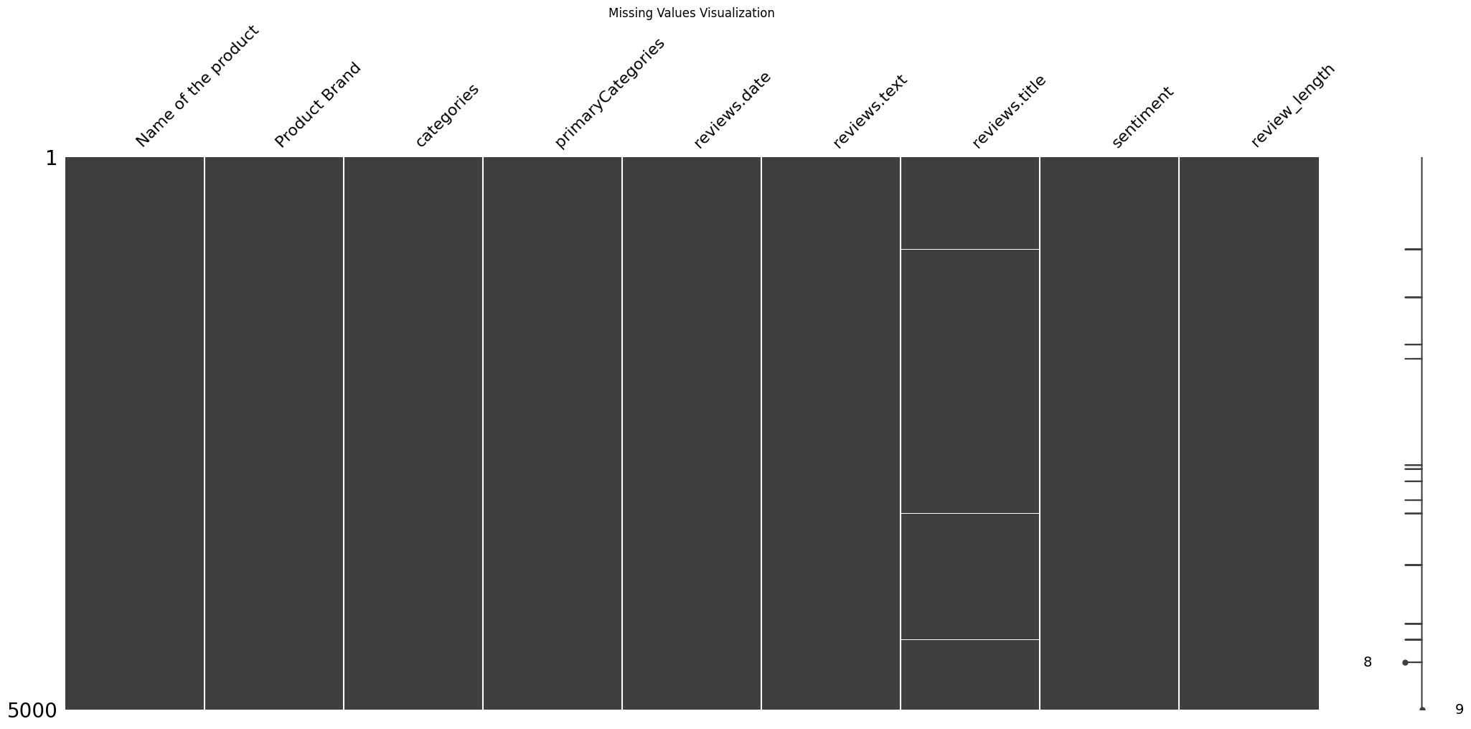
Missing Values Visualization
Findings- From the above we found there are 13 missing values in the reviews.title column

Slide 6
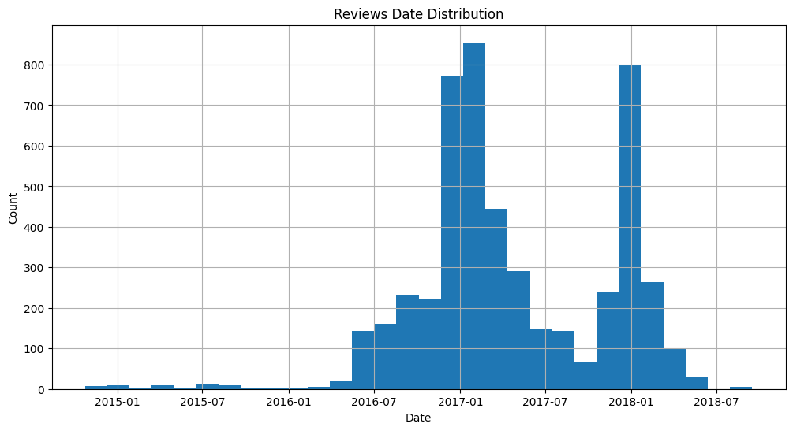
Reviews Date Distribution
A reviews date distribution graph shows the frequency of reviews over time, indicating trends in customer engagement or interest in the product.

Slide 7
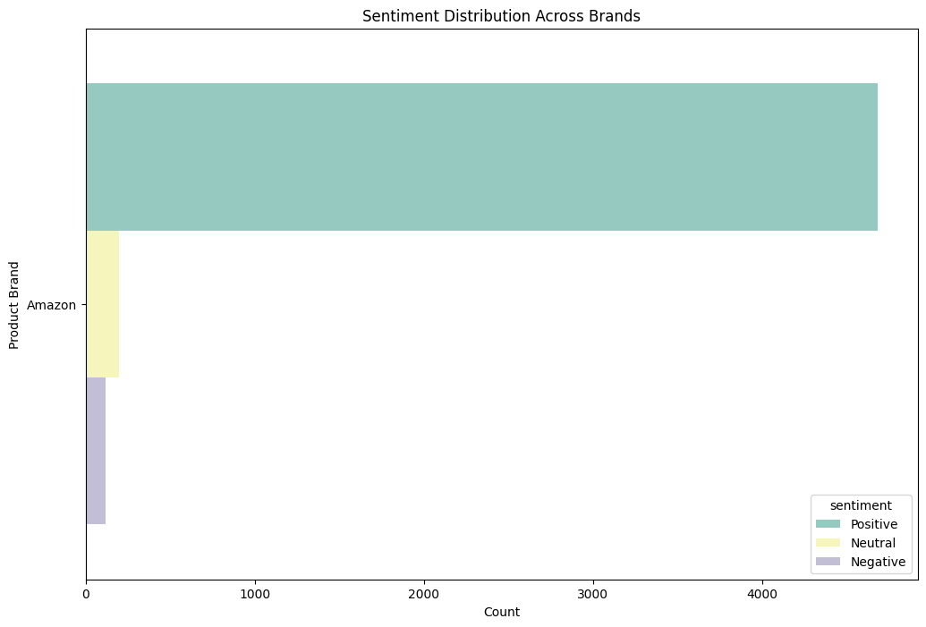
Sentiment Distribution Across Brands
A sentiment distribution graph for Amazon reviews shows the proportion of positive, negative, and neutral sentiments, providing insight into overall customer satisfaction and feedback trends.

Slide 8
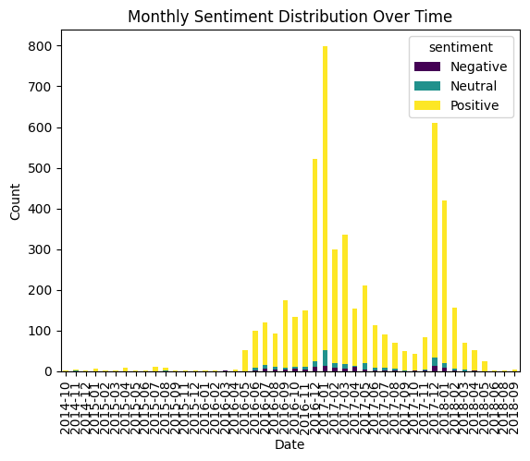
Monthly Sentiment Distribution Over Time
A monthly sentiment distribution over time graph illustrates the changes in the proportions of positive, negative, and neutral sentiments in Amazon reviews each month. This can reveal trends, such as shifts in customer sentiment, seasonal patterns, or the impact of specific events on customer perceptions.

Slide 9
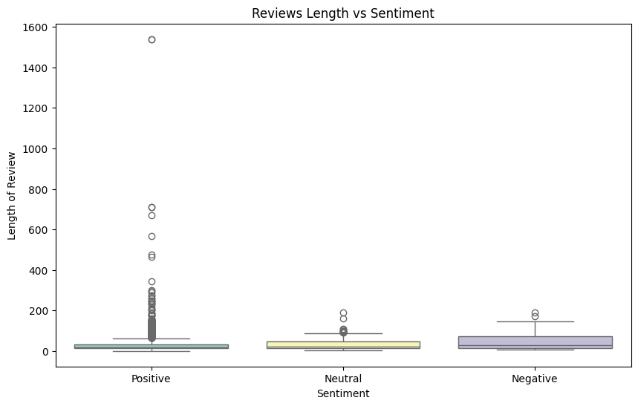
Reviews length vs sentiment
A review length vs. sentiment graph shows the relationship between the length of reviews (measured in characters or words) and the sentiment (positive, negative, or neutral). This can provide insights into whether longer reviews tend to be more positive, negative, or neutral, or if there is any notable pattern in the sentiment based on review length.

Slide 10

Word Cloud for Reviews Title

Slide 11
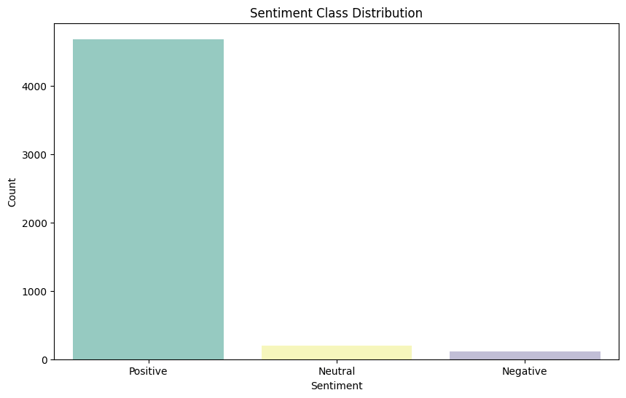
Sentiment Class Distribution
The sentiment class distribution for an unbalanced dataset indicates the proportion of each sentiment class (positive, negative, neutral) relative to the others. In an unbalanced dataset, one or more sentiment classes are underrepresented compared to others. This distribution highlights the need for techniques like over sampling, under sampling to address potential bias in sentiment analysis models.

Slide 12
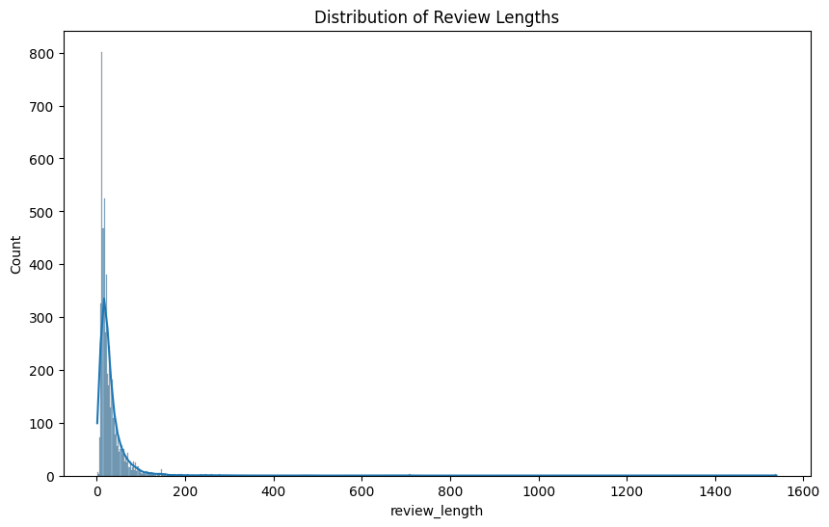
Distribution of Review Lengths
The distribution of review length shows how the number of reviews varies with different lengths (measured in words or characters). It can reveal patterns such as whether most reviews are short or long and can help in understanding customer engagement levels and verbosity. This distribution can be visualized as a histogram or density plot, indicating how frequently reviews of different lengths occur.

Slide 13
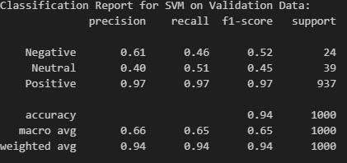
SVM classifier
Observations:
The model performs very well on the Positive class due to the high number of instances and the associated metrics close to 1.
Performance on the Negative and Neutral classes is lower, with a significant drop in recall and precision, likely due to the imbalance in the dataset, where these classes are underrepresented. This results in lower F1-scores for these classes.
The high overall accuracy is driven primarily by the correct classification of the Positive class, but the macro average shows that performance is not consistent across all classes.

Slide 14
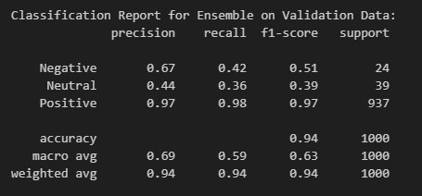
Ensemble Techniques
Using ensemble methods such as XGBoost combined with Naive Bayes
Observations:
The ensemble model slightly improves overall accuracy compared to the SVM model, achieving 0.95.
The Positive class continues to show high precision, recall, and F1-score, indicating that the model is particularly effective in identifying positive reviews.
Performance on the Negative and Neutral classes shows a mixed result. The precision for the Neutral class improves slightly, while recall decreases, suggesting some changes in how the model balances precision and recall.
The Negative class shows a slight improvement in precision but a lower recall, resulting in a relatively low F1-score.
The macro average F1-score is slightly lower than the SVM's, indicating continued challenges in consistently classifying the less represented classes, despite a slight improvement in macro average precision.

Slide 15
LSTM Implementation
Interpretation
The final evaluation on the validation set shows an accuracy of 0.9418 and a loss of 0.3309. The high training accuracy and lower validation accuracy, along with the increasing validation loss over epochs, indicate that the model has likely overfit to the training data. This is evidenced by the large gap between the near-perfect training accuracy and the relatively lower validation accuracy and higher validation loss.
Overall, while the model has learned the training data very well, its generalization to new, unseen data (validation set) is less optimal, suggesting that further regularization techniques or early stopping could help prevent overfitting and improve model performance on the validation set.

Slide 16
Bidirectional LSTM
Reducing Overfitting with Dropout and Early Stopping
Finding:
The training accuracy increases significantly and stabilizes towards the end of the epochs, reaching nearly perfect accuracy (0.999).
Validation accuracy shows some fluctuations but generally improves, peaking at 0.946 and then stabilizing
Interpretation
The model demonstrates high accuracy and low loss on both training and validation sets by the end of the training, indicating effective learning.
Minor fluctuations in validation accuracy and loss suggest that while the model performs well, there might be slight overfitting or variability in generalization.
The consistent decrease in training loss and the relatively stable validation metrics towards the end indicate that the dropout and early stopping techniques are likely helping to control overfitting and improve generalization.

Slide 17


